Slide 1


Your User Manual
A simple leadership blueprint to boost team alignment, trust and connection
Brought to you by: Desa Global Leadership & Inspired by Atlassian

Slide 2
Make it a Team Exercise!
Invite everyone on your Team to create and share their User Manual
The Objective: To create common understanding within the team by articulating and sharing preferences and learning styles upfront. To create a more inclusive team working environment via learning and respecting diversity within the team.
The Process:
Pre work: Send out one of the templates and ask each team member to bring a draft to the next team meeting and be ready to share.
During the Meeting: Compile all slides into 1 Team Manual and take turns presenting your user manual highlights. Allow a few minutes for comments and questions from team members. Have fun with this! You may want to include a team photo.
After the Meeting: Keep the Team deck somewhere accessible and add to it when new members join the team. Have the new teammate fill their own out and present to the team by way of an onboarding/introduction.

Slide 3
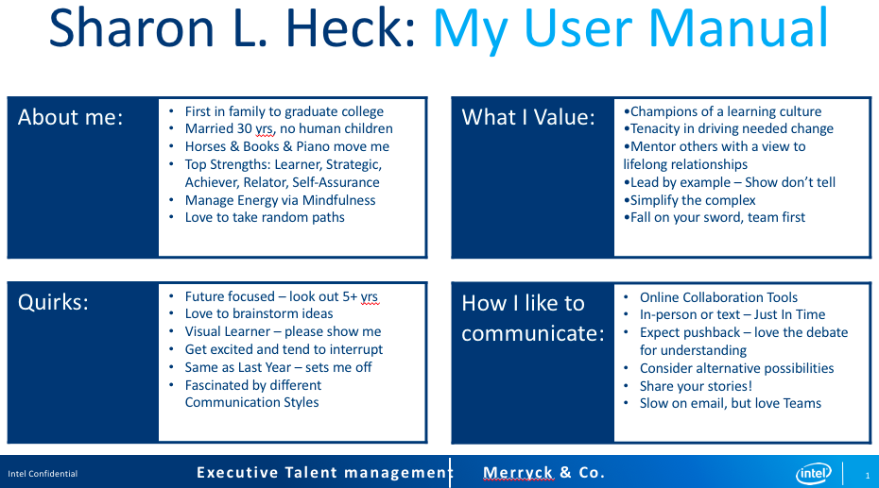
Sharon L. Heck, Vice President, Head of Tax at GE Vernova has kindly agreed to share her User Manual.
Feel free to connect with her & share your feedback with her via LinkedIn: https://www.linkedin.com/in/sharon-l-heck/

Slide 4
[Name]’s User Manual
About Me:
[Example: I'm not naturally expressive, so people can find me hard to read. If I’m not happy I will let you know, so otherwise assume I am fine!]
[Example: My top strengths are thinking creatively, absorbing data and problem solving - share relevant Leadership Assessment Results.]
[Example: Married for 10 years and have two children.]
What I Value:
[Example: I'm an introvert, so working "in the open" is something I have to work hard at.]
[Example: I learn via stories and appreciate data & sources to back them up.]
[Example: I have a growth mindset so feel free teach me something new.]
Quirks:
[Example: If I have my headphones on, I am in focus mode, so please do not disturb me.]
[Example: I only accept meeting invites if there is an agenda attached.]
[Example: I love brainstorming & list making with post-its so I always have some nearby.]
How I like to communicate:
[Example: I check my emails once a day and usually respond within 48 hours at the latest.]
[Example: Text is the quickest way to get an urgent response from me.]
[Example: I'd rather have courageous conversations in person. I appreciate and practice radical candour.]
Notes:
Template #1

Slide 5








[Name]’s User Manual
You
What are three things people should know about you?
Others
What irritates you ALOT? Pick only three things.
Fun
What song is guaranteed to make you sing or dance? What's your favorite hobby right now?
Values
Top three values for you in life.
Balance
What brings you back to centre when stressed?
Communication
What are the BEST and WORST ways to communicate with you?
Feedback
How and when do you like critical feedback?
Achievement
What’s your proudest achievement?
Notes:
Template #2

Slide 6



Did you try these exercises? What was the impact? We’d love to hear!
For more actionable & awesome leadership tools, check out desagloballeadership.com
Connect with us!
tania@desagloballeadership.com

